Slide 1
Introduction To MySQL

Slide 2
Agenda
History of MySQL
A summary of the features
The MySQL Architecture
Database engines
Tools for working with MySQL
Basic MySQL commands
Where to go to learn more about MySQL
Questions

Slide 3
The MySQL Timeline
First developed in the 1980’s as an in-house data warehouse for a Swedish company called TcX.
The first widely available version of MySQL was released in 1996.
The first transactional database engine, Berkeley-DB (BDB), was added in 2001, and the InnoDB database engine was added in 2002.
MySQL version 4.0 was considered the first commercially viable version of MySQL.
MySQL version 5.0 was released in 2005.
Sun acquired MySQL AB in 2008.
Oracle acquired MySQL through the acquisition of Sun in 2009.
MySQL version 5.1 was released in 2008.
MySQL version 5.5 is the current production release.
Percona and MariaDB are the most widely used derivatives of MySQL.

Slide 4
MySQL Features
MySQL is freely downloadable and offers low ownership costs.
Can be embedded into applications that run on everything from servers to mobile devices.
Utilizes a multitude of transactional (ACID-compliant) and non-transactional database engines.
Offers many of the same features found in commercial database software:
High availability
Partitioning
Views and store routines (triggers, functions, stored procedures)
Full-text indexes
Enforcement of business rules through constraints

Slide 5
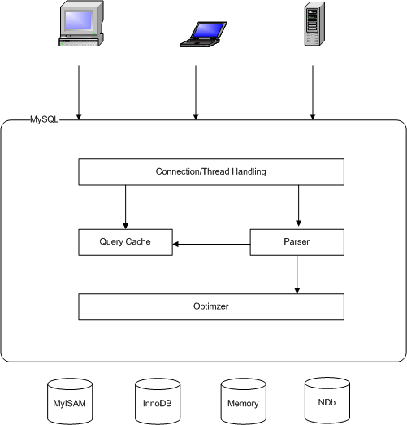
MySQL Architecture

Slide 6
Database Engines
MySQL offers the ability to use different database engines depending on your specific needs.
The main database engines used by MySQL are:
MyISAM – Non-transactional engine. This was the default database engine prior to version 5.5.
InnoDB – Transactional engines. This is currently the default database engine.
Memory – A non-transactional engine that is used to store data in memory. MySQL uses this engine for sorting and for temporary tables.
nDB - This is a transactional engine used only in MySQL clustering.
Some of the other database engines available to MySQL.
CSV
Archive
Federated
Merge
ExtraDB
Aria

Slide 7
MySQL System Databases
Base System Databases
MySQL – The MySQL database is used to manage database security and is loaded into memory upon startup.
Information_schema – This was introducted in MySQL 5.1. Th information_schema database acts as the data dictionary for MySQL.
Performance_schema – Introducted in MySQL 5.5, this database contains performance counters that can be used for tuning the database.

Slide 8
Tools for Working with MySQL
mysql – This is the command line tool for access a MySQL instance.
mysqldump – Utility for creating logical backups of the database.
mysqlbinlog – This is a utility for reading the bin logs of a MySQL instance.
mysqladmin – This tool is used for performing administrative tasks of the database at the operating system command line.
mysqlcheck – A tool for performing table maintenance tasks (checking, repairing, optimizing, and analyzing tables).
MySSQL log files – These files are used to monitor the health and performance of MySQL.
Error Log – MySQL writes all errors and warnings to this file.
Slow-Query Log – This log is used to identify SQL statements that are running slowly and may need to be tuned (disabled by default).
General Log – All activities occurring on the database are recorded in this file (disabled by default).
Bin Logs – Archived transaction logs. MySQL uses these files to restore itself to a prior state.

Slide 9
Basic MySQL Commands
Logging in to MySQL
mysql –h <hostname> [-P port #] [-D database] –u <username> -p
Example: mysql –h localhost –u troym -p
Show Databases
SHOW DATABASES;
Show Tables in the current database
SHOW TABLES;
Show Variables
SHOW VARIABLES; (shows all variables)
SHOW VARIABLES LIKE ‘[%]<variable_pattern[%]’;
SHOW VARIABLES LIKE ‘innodb%’;
Change Databases
USE <database name>;
Describe a table or a view
DESC [<database name>].<table_name>

Slide 10
More Basic MySQL Commands
Show server status – Show the current server status information either globally or for a session.
SHOW [GLOBAL|SESSION] STATUS;
Run a file either internally or externally
Internally: source <file_path>;
Externally: mysql –h <host> -u <username> -p < <pathname>
Example: mysql –h localhost –u troym –p < ‘c:\temp\file.sql’
Print output to a file
Internally: SELECT <column(s)> FROM <table(s)> INTO OUTFILE <pathname>;
Example: SELECT user from mysql.user INTO OUTFILE ‘c:\temp\file.sql’;
Externally: mysql –u <usename> -p –e “<Query>” > <pathname>
Example: mysql –u tmcdonald –p –e “Select user from mysql.user” > ‘c:\temp\file.sql’
View help topics within MySQL
Help <command>
Example: HELP CREATE DATABASE;

Slide 11
Even More Basic MySQL Commands
Check the Slave Status – Use this command to verify that replication is working correctly.
SHOW SLAVE STATUS\G
Stop, Start, and Reset Slave – Start and stop slave does just that, starts and stops the slave. Reset slave causes the slave to forget its current position in the master’s binary log and starts a new relay log file.
STOP SLAVE;
START SLAVE;
RESET SLAVE;
Check the Master Status – This command is used to display information about the binary log files of the master.
SHOW MASTER STATUS;
Reset Slave – The reset slave command is used to remove all binary logs listed in the index file, resets the index file, and then creates a new bin log.
Stop and start MySQL in Linux/Unix
/etc/init.d/mysql.server start
/etc/init.d/mysql.server stop

Slide 12
Where to go to learn more about MySQL
MySQL websites
dev.mysql.com – Go here to download software, access product manuals, whitepapers, product guides, and participate in user forums.
www.percona.com - This website contains everything you want to know about the Percona variation of MySQL.
mariadb.org – The mariadb website contains information about this variation of MySQL that was created by the founder of the MySQL.
Books
MySQL Reference Manual
MySQL, Fourth Edition – By Paul DuBois
High Performance MySQL – By Baron Schwartz, Peter Zaitsev, and Vadim Tkachenko
MySQL High Availabilty – By Charles Bell, Mats Kindahl, and Lars Thalman

Slide 13
Questions?

